Slide 1
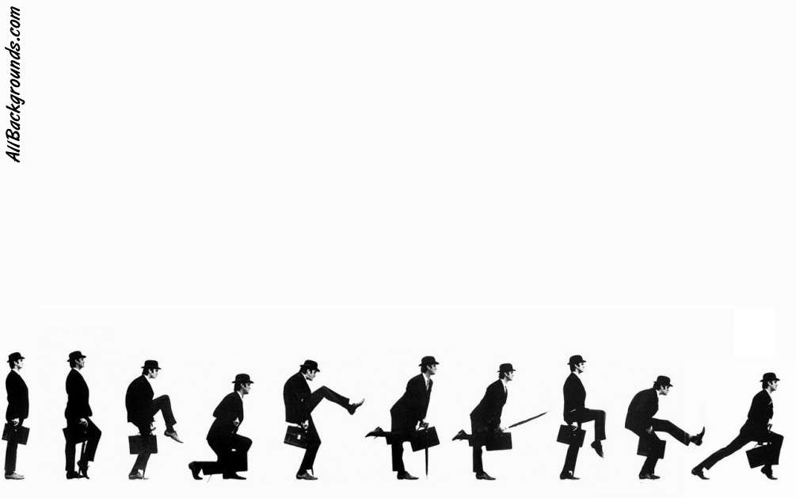
Python
Introduction to Programming
Comp07027
Lecture 14

Slide 2
OOP 4
Inheritance & Encapsulation

Slide 3
What has OOP ever done for us??
Object Oriented Program has three very useful properties:
Polymorphism
Inheritance
Encapsulation

Slide 4
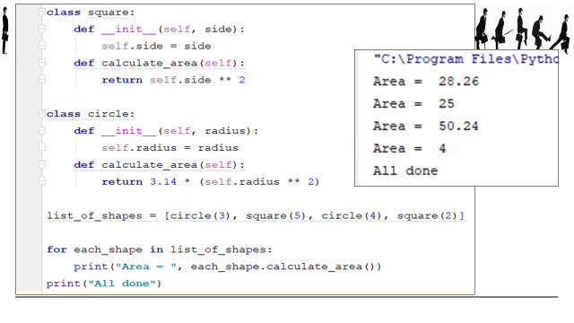
Polymorphism
We have already seen (and used) polymorphism.
Polymorphism is ability to treat different objects in the same way e.g. different methods with the same name in different objects.

Slide 5
What has OOP ever done for us??
Let’s look at Inheritance now

Slide 6
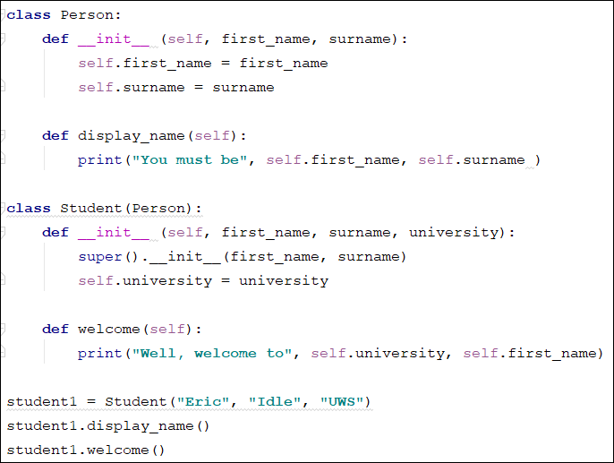
Inheritance
Inheritance allows us to define a class that inherits all the methods and properties from another class.

Slide 7
We create a class called Person exactly as we have done before.
Person has a first name and a surname, and a method to display them.
Inheritance

Slide 8
We create a class called Person exactly as we have done before.
Person has a first name and a surname, and a method to display them.
Inheritance
We now add a class called Student (which is a type of person!).
Student has a first name, a surname and a university, and a method to display the first name and university.

Slide 9
Notice that our declaration of Student is different: class student(person)
This creates a relationship by passing Person to Student as a parameter.
Person is the PARENT class and Student is the CHILD class. The child class INHERITS from the parent class i.e. Student can use the properties and methods from Person.
Inheritance

Slide 10
Inheritance
However, Student can also add its own properties and methods:
Student gets first_name and surname from Person, but university is from Student.

Slide 11
Inheritance
We can now create a Student object, student1, with a first name, surname and university.
Then we can call the methods
display_name from Person
welcome from Student

Slide 12
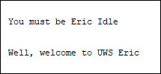
Inheritance
We can now create a Student object, student1, with a first name, surname and university.
Then we can call the methods
display_name from Person
welcome from Student

Slide 13
What has OOP ever done for us??
Finally we look at Encapsulation

Slide 14
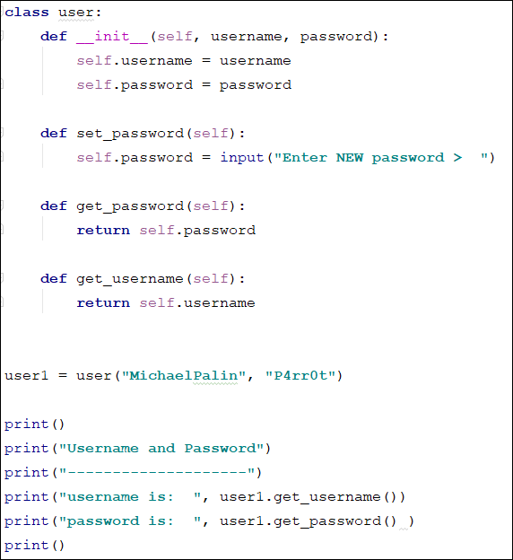
Encapsulation
We create a class called user.
The class has two attributes – username and password.
We define methods to set (change) the password, and another two to get the password, and get the username.

Slide 15
Encapsulation
We also create a method to display the details!
We do not usually do this, it is merely included to let us see what is happening while we are coding.
If we run the program ….

Slide 16
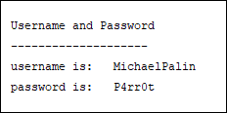
Encapsulation
We also create a method to display the details!
We do not usually do this, it is merely included to let us see what is happening while we are coding.
If we run the program ….

Slide 17
Encapsulation
This is clearly not very secure!!!!
Any programmer can display a user’s username and password.

Slide 18
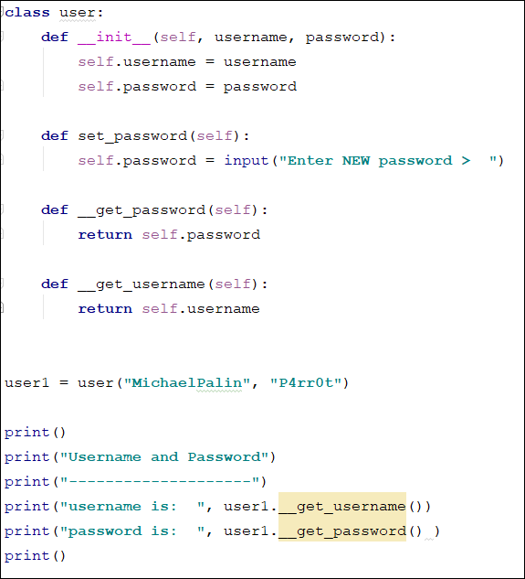
Encapsulation
If we make a slight change (put two underscores before the methods’ names) we can make them private.
Now …..

Slide 19
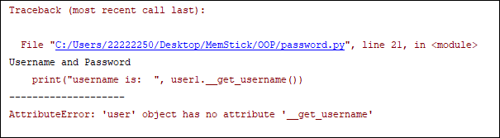
Encapsulation
If we make a slight change (put two underscores before the methods’ names) we can make them private.
Now …..
__get_username() is not recognised because it’s hidden

Slide 20
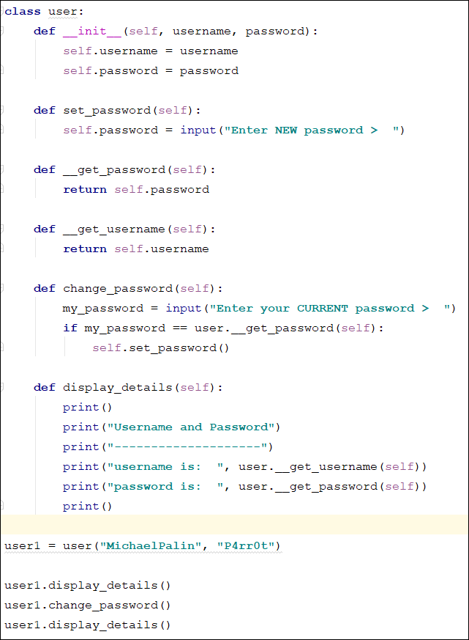
Encapsulation
We have now added two methods, one to change the password, one to display (to help with coding).
These methods can access the hidden methods because they are also inside the class.
Now when we run the program ….

Slide 21
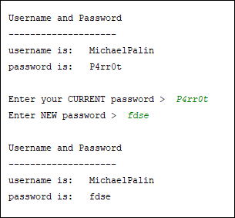
Encapsulation
We have now added two methods, one to change the password, one to display (to help with coding).
These methods can access the hidden methods because they are also inside the class.
Now when we run the program ….

Slide 22
Encapsulation
So, what have we achieved??
We can now create code which will access the password from outside the object and allow us to check it without revealing it!
That’s much more secure.
Let’s make the program a bit more flexible …..

Slide 23
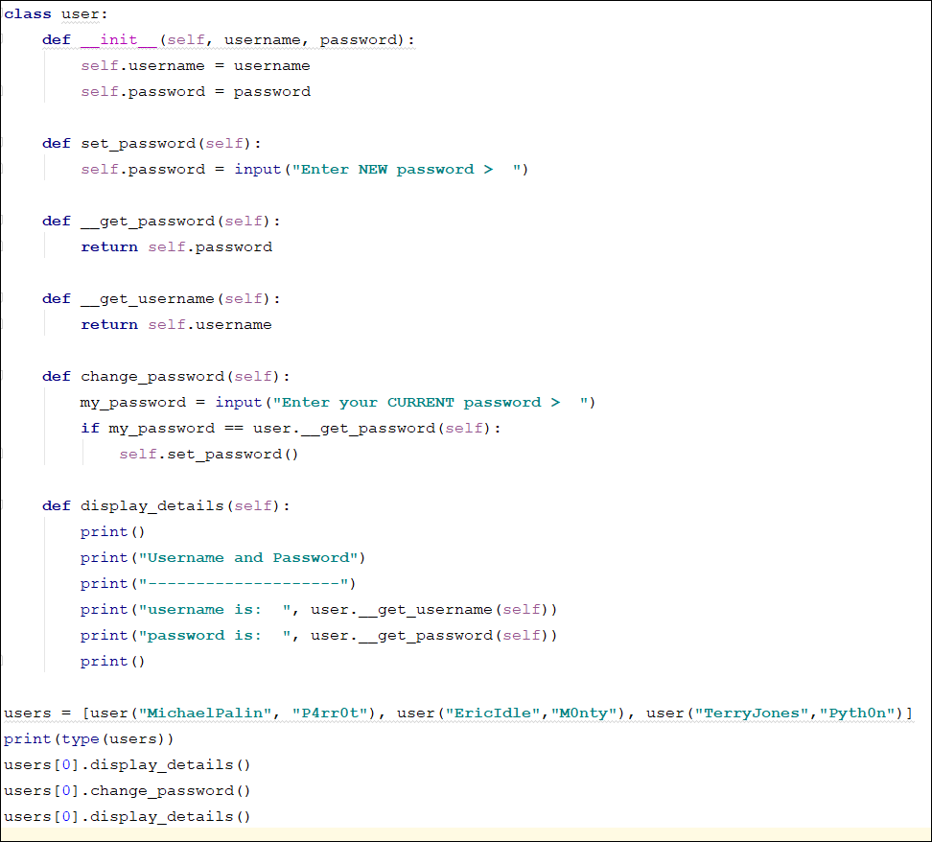
Encapsulation
Instead of individual variables (user1, user2) let’s put all the instances of user in a list called users[]

Slide 24
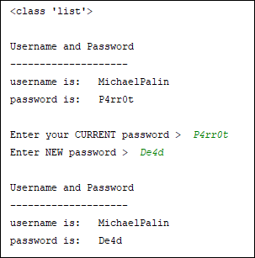
Encapsulation
Instead of individual variables (user1, user2) let’s put all the instances of user in a list called users[]
Now we can append, find, add, delete, pickle and lots of other fun stuff!!!

Slide 25
For next week
Exercise 1
Write a program to demonstrate what inheritance is.
Use Animals, Felines and Lions.
This will require three layers!!

Slide 26
For next week
Exercise 2
Create the username/password example from the slides.
Add a menu at the front which allows us to
Add a new user
Delete a user
Change the password

Slide 27
For next week
Exercise 3
Create the username/password example from the slides.
Add a menu at the front which allows us to
Add a new user
Delete a user
Change the password
Now PICKLE it

Slide 28
Questions??

